Slide 1

Computer Networks
By
Dr. Kanchan Shende

Slide 2
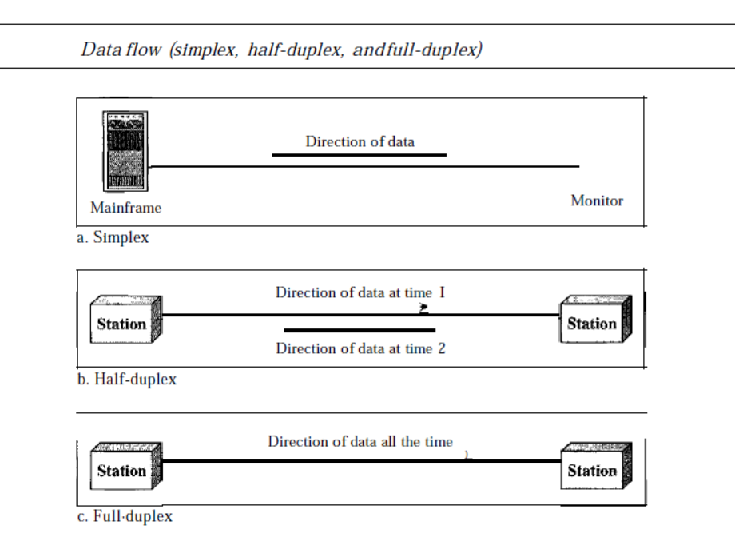
Data Flow
SoCS, MIT-WPU

Slide 3
Conti…
Simplex
In simplex mode, the communication is unidirectional, as on a one-way street. Only one of the two devices on a link can transmit; the other can only receive.
Keyboards and traditional monitors are examples of simplex devices.
The keyboard can only introduce input; the monitor can only accept output. The simplex mode can use the entire capacity of the channel to send data in one direction
SoCS, MIT-WPU

Slide 4
Conti…
Half-Duplex
In half-duplex mode, each station can both transmit and receive, but not at the same time. : When one device is sending, the other can only receive, and vice versa.
The half-duplex mode is like a one-lane road with traffic allowed in both directions.
The half-duplex mode is used in cases where there is no need for communication in both directions at the same time; the entire capacity of the channel can be utilized for each direction.
SoCS, MIT-WPU

Slide 5
Conti…
Full-Duplex
In full-duplex mode both stations can transmit and receive simultaneously.
One common example of full-duplex communication is the telephone network. When two people are communicating by a telephone line, both can talk and listen at the same time.
The full-duplex mode is used when communication in both directions is required all the time. The capacity of the channel, however, must be divided between the two
directions.
SoCS, MIT-WPU

Slide 6
Networks : point-to-point connections, multipoint connections
Network :
A network is a set of devices (often referred to as nodes) connected by communication links.
A node can be a computer, printer, or any other device capable of sending and/or receiving data generated by other nodes on the network.
SoCS, MIT-WPU

Slide 7
Conti…
Distributed Processing
Most networks use distributed processing, in which a task is divided among multiple computers.
Instead of one single large machine being responsible for all aspects of a process, separate computers (usually a personal computer or workstation) handle a subset.
SoCS, MIT-WPU

Slide 8
Conti…
Network Criteria :
Performance
Reliability
Security
SoCS, MIT-WPU

Slide 9
Conti…
Performance :
Transit time and Response time
Number of users,
Type of transmission medium
Capabilities of the connected hardware
Efficiency of the software
Throughput and delay
SoCS, MIT-WPU

Slide 10
Conti…
Transit time : Transit time is the amount of time required for a message to travel from one device to another.
Response time : Response time is the elapsed time between two nodes.
SoCS, MIT-WPU

Slide 11
Conti…
Reliability:
Measured by the frequency of failure.
The time takes a link to recover from a failure
The network’s robustness in a catastrophe.
SoCS, MIT-WPU

Slide 12
Conti…
Security:
Protecting data from unauthorized access.
Protecting data from damage and development.
Implementing policies and procedures for recovery from breaches and data losses.
SoCS, MIT-WPU

Slide 13
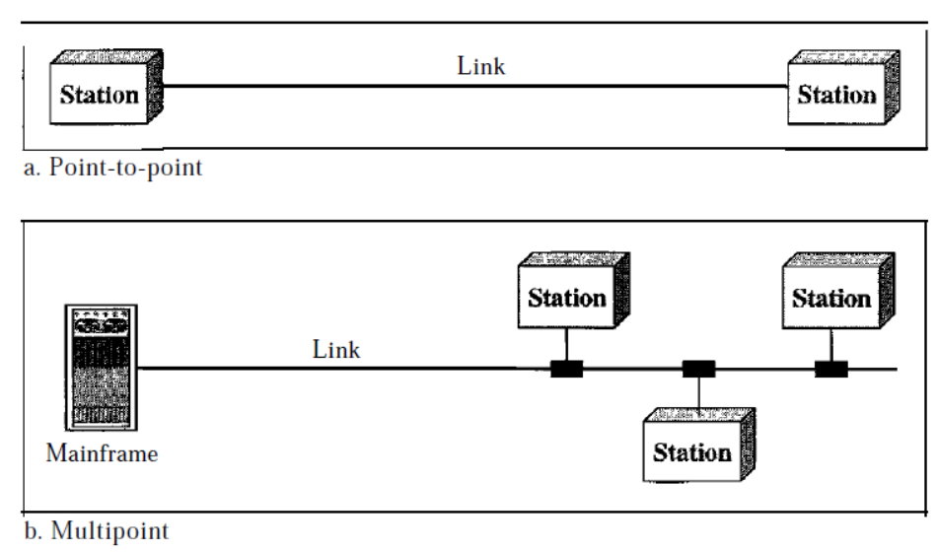
Type of Connection
There are two types of connections:
Point-to-Point
Multipoint
SoCS, MIT-WPU

Slide 14
Conti…
Point-to-Point :
A point-to-point connection provides a dedicated link between two devices.
The entire capacity of the link is reserved for transmission between those two devices.
Example: When you change television channels by infrared remote control, you are establishing a point-to-point connection between the remote control and the television's control system.
SoCS, MIT-WPU

Slide 15
Conti…
Multipoint
A multipoint (also called multidrop) connection is one in which more than two specific devices share a single link.
In a multipoint environment, the capacity of the channel is shared, either spatially or temporally.
If several devices can use the link simultaneously, it is a spatially shared connection. If users must take turns, it is a timeshared connection.
SoCS, MIT-WPU

